Slide 1
4-Day School Week
September 21, 2022

Slide 2
Purpose
To explore the possibility of JISD moving to a 4-day work week

Slide 3
Results of the April 2022 Survey

Slide 4
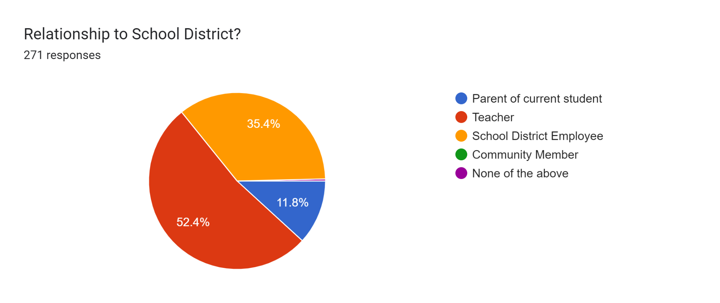
Survey Respondents

Slide 5
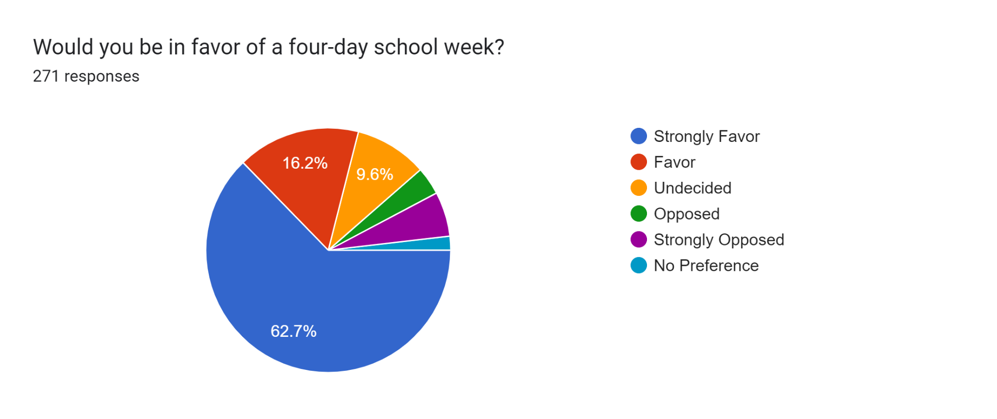
Percent in favor of a 4-day school week

Slide 6
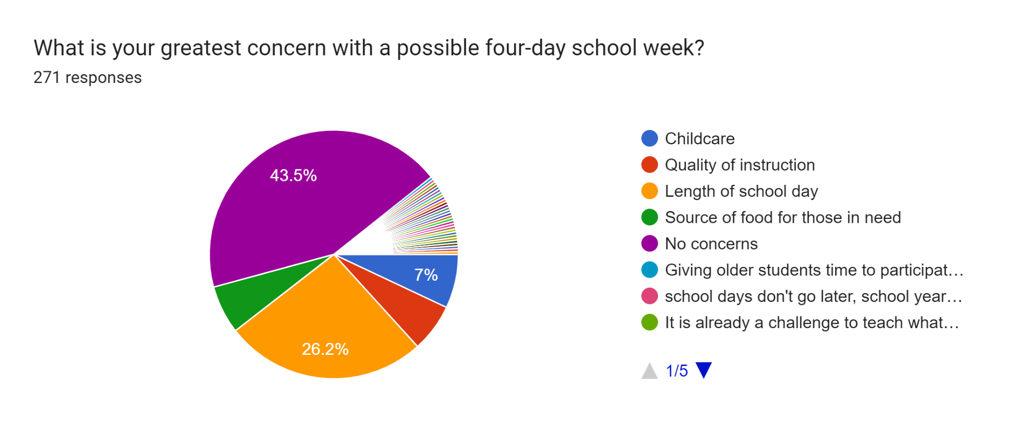
Greatest Concerns…

Slide 7
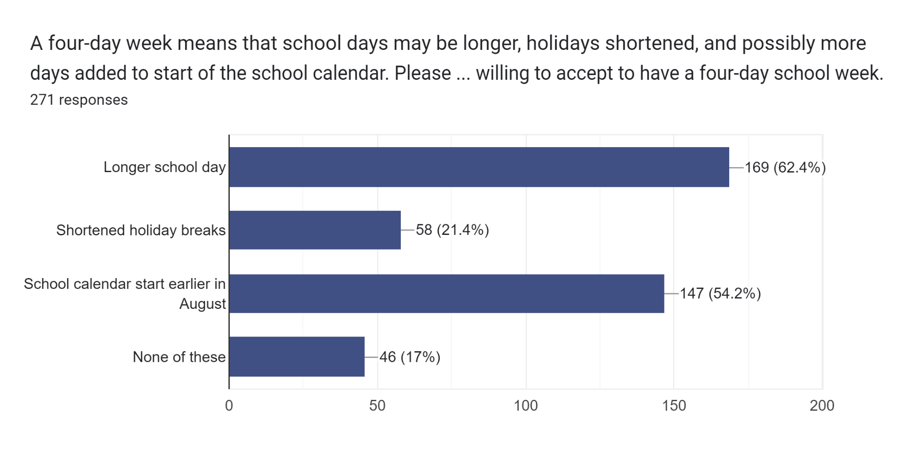
75,600 minutes…

Slide 8
Positive Impact
86% agreement that 4-day school week would improve attendance
87% agree that 4-day school week would impact their family in a positive way
90% would remain in JISD if we moved to a 4-day school week

Slide 9
Based on these survey results, what is the consensus?

Slide 10
12%
Percent of parent respondents

Slide 11
What are our next steps in this process?
Form exploratory committees for any barriers identified in the survey
Childcare
Instructional quality -Teach the same amount of content in fewer days
Length of school day
Longer school year
How to increase parent responses on a second survey

Slide 12
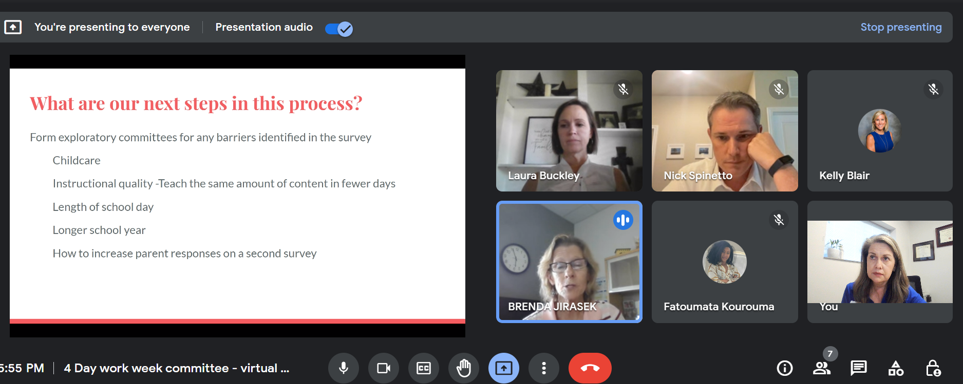
Attendees

